Slide 1
Chapter 2: The Sonographer: A Closer Look

Slide 2
Chapter Objectives
Examine personality typewatching and emotional intelligence and how they relate to sonography.
Appreciate work ethic in sonography.
Recognize how vital character is to the sonographer.
Understand the responsibilities and challenges of the clinical sonographer.
Comprehend the need to effectively communicate with sonographers and interpreting physicians.

Slide 3
Know Yourself Before You Know Others
Ask yourself these questions:
Do you know yourself?
If you know yourself, can you change the things that you do not like?
Identifying your personality type helps you understand:
How you view others
How you can utilize your strengths in sonography
How you can improve your interactions with people, especially patients

Slide 4
Identifying Your Personality Type
The Myers-Briggs type Indicator is an approach to analyzing personality type.
It helps identify your tendency toward a certain personality type (typewatching).
It posits that people have inclinations toward definite personality types combining the following preferences:
Extroversion (E) or introversion (I)
Sensing (S) or intuition (N)
Thinking (T) or feeling (F)
Judging (J) or perceiving (P)
There are 16 possible personality types.
A temperament and character inventory (TCI) examines seven basic personality dimensions of temperament and character.
Personality tests are readily available online.

Slide 5
Identifying Your Personality Type (cont.)
Extroversion: You typically tend to speak first and think later, enjoy parties and being in a crowd, and don’t mind sharing your many opinions.
Introversion: You prefer to be in a small group of people you know—and in fact enjoy being alone—and you are considered a good listener.
Sensing: You prefer to focus on concrete ideas and prefer specific answers and less theory.
Intuition: You enjoy figuring out how things work, look forward to your future prospects, and can multitask.
Thinking: You believe in truth and justice, are impartial, and are not concerned with popularity.
Feeling: You try to avoid conflict, love helping others, and often sacrifice for the good of others.
Judging: You don’t like surprise parties, look serious most of the time, and enjoy keeping lists.
Perceiving: You find it difficult to focus on one task at a time, enjoy playing games, and cherish new experiences.

Slide 6
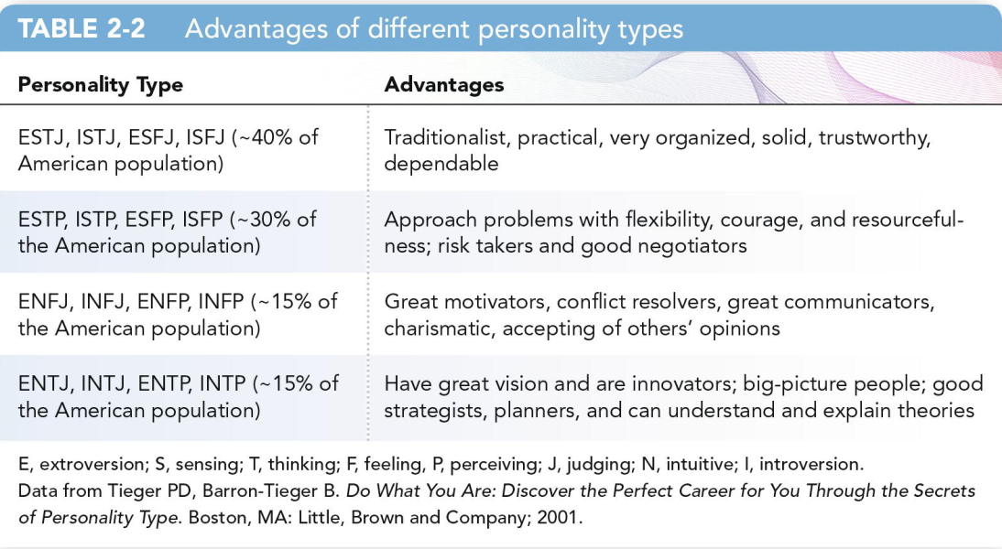
Identifying Your Personality Type: Why?
As many as 30% of all companies now use some form of personality testing as part of the interviewing process.
Understanding your personality type can help you prepare for the interview.
You can look for situations in which you can best utilize your abilities.

Slide 7
Five-Factor Model
Five-Factor Model (FFM), also known as the Big Five personality traits, is another structure used for the classification of personality traits.
The Big Five traits of personality are domains that define personality and account for individual differences. These traits include openness, conscientiousness, extraversion, agreeableness, and neuroticism.
The FFM can predict other life outcomes, such as achievement in school and work, physical and mental health, and social behavior.

Slide 8
Five-Factor Model (cont.)
Openness to experience refers to one’s inclination toward being autonomous, imaginative, and independent minded.
Conscientiousness relates to dependability, being responsible, and orderliness.
Extraversion is described as being outgoing, sociable, and energetic.
Agreeableness is one’s tendency toward being accommodating, caring, and trusting.
Neuroticism relates to emotional stability and the ability to remain calm and composed under duress.

Slide 9
Emotional Intelligence (EI)
The fundamental thought is that those who have fully developed EI have an enhanced ability to recognize emotions in themselves and others.
They also have the capacity to use those emotions to improve emotional and intellectual growth and decision-making.
High EI is essential for healthcare professionals.
It may represent a set of core competencies for identifying, processing, and managing emotions that enable nurses to cope with daily demands in a knowledgeable, approachable, and supportive manner.
It is important in decision-making in the clinical environment and in growth of professional relationships.
Multiple tests are available online.

Slide 10
Emotional Intelligence (EI) (cont.)
Self-awareness—Having a thorough understanding of one’s emotions, strengths, weaknesses, needs, and ambition
Self-regulation—An ongoing conversation we must have with ourselves that frees us from feelings
Motivation—To achieve beyond everyone’s expectations, including one’s own; to achieve for the sake of achieving
Empathy—Being aware of and considerate of other people’s feelings
Social skills—Combining friendliness, cooperation, and effective communication to improve interactions

Slide 11
Strength Recognition and Professional Maturation
Our personalities are strongly influenced by genetics and early experiences over which we have no control.
Even if you meet someone with the same Myers-Briggs personality type, you will be very different.
You may not be able to change the basic components of your personality, but you can control how your traits are expressed.
For example, an extrovert can make a conscious attempt to listen first and sort thoughts carefully before talking.
If a single part of your personality is causing you concern, you should find alternative, less destructive ways to express those traits.
Personality tests determine only propensity toward behaviors.
Learning about your own strengths and weaknesses is a lifelong challenge.
You must first want to change to make a change.

Slide 12
Strength Recognition and Professional Maturation (cont.)
Accepting and making appropriate mediations to the manner in which we present ourselves to others is part of the personal maturation process.
Accordingly, the maturation from student to independent sonographer is much like maturing from an adolescent to an adult.
In 1994, Robert Kegan coined the term self-authorship.
Kegan made the argument that the self-authoring mind is a necessary foundation for adults to accomplish in order to meet the typical expectations of work, home, and school.
Adult development should be a journey from dependence on external authorities to a more mature system of the mind.

Slide 13
Strength Recognition and Professional Maturation (cont.)
The self-authoring mind is independent, is leadership driven, has strong problem-solving abilities, and is capable of making critical decisions rapidly because he or she has a well-developed internal compass.
The self-authored individuals have an internal “seat of judgment” and the ability to make choices about external expectations outside of the social environment and are self-initiating, guided by their own visions, responsible for their experience, and able to develop interdependent relations with a wide variety of individuals.
Self-authorship encourages stronger relationships because the focus is on creating authentic mutually beneficial relationships instead of reactionary superficial associations.

Slide 14
Strength Recognition and Professional Maturation (cont.)
In contrast, the socialized mind is one that responds to the environment around it constantly, simply bouncing from reaction to action.
These individuals are good team players and faithful followers, but unfortunately find that their primary motivator for behavior is the approval of others.
Kegan discovered that regrettably about 58% of adults primarily operate using a socialized mind, while only 35% operate with a self-authored mind.
The self-authored sonographer continually recognizes the innate value of each patient, continues to learn and build a knowledgeable foundation, acknowledges the need to understand more about his or her patients and career, and selflessly begins to serve.

Slide 15
Strength Recognition and Professional Maturation (cont.)
Maturing as a sonographer takes time and experiences.
Moving from a socialized mind to a self-authoring mind should be your goal.
But it all begins with acknowledging the fact that serving patients is the fundamental priority of all sonographers.

Slide 16
Serving in Healthcare
Working in healthcare demands physical and emotional fortitude.
Ethics at work demands knowing the right thing to do and then doing it.
Employers want employees who demonstrate honesty and integrity.
Patients and employers value:
Positive attitudes
Clear communication
Respect
Reliability
Compassion and empathy
Sincerity
Friendliness

Slide 17
Character
Character is the way a person thinks, feels, and acts.
Personal values are tenets a person holds in high regard.
In combination, character and personal values form a person’s reputation.
You must start off on the right foot in healthcare, as your reputation will follow you.
The sonography profession is a small community.
Recognize that activity on social media may be examined by prospective employers.
The American Society of Echocardiography calls for the following traits in sonographers: flexibility, enthusiasm, and confidence.

Slide 18
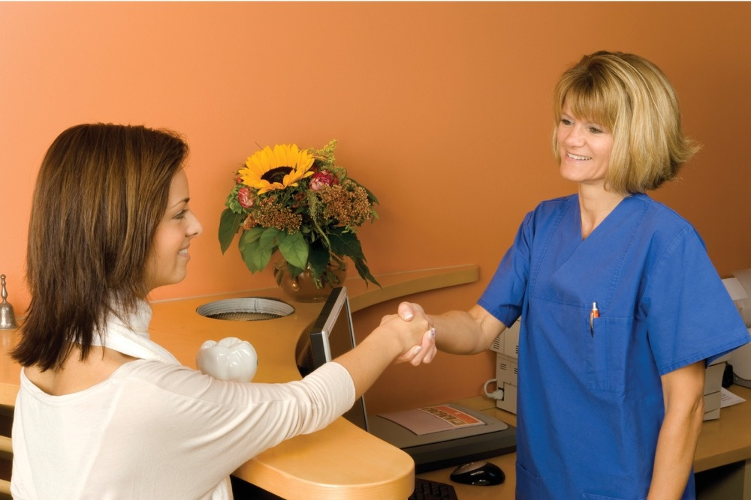
Serving in Healthcare (cont.)
Enthusiasm is one of many important personal attributes for healthcare workers.

Slide 19
Competent Care and Flexibility
Competence is the possession of necessary knowledge and skills to carry out a specific job appropriately and safely in a consistent manner.
There are standards in sonography programs to normalize competency and education.
These standards are the minimum requirement to which an accredited program is held accountable.
Clinical competencies ensure that you can perform sonographic procedures unassisted.
You must keep up to date on current procedures, techniques, technology, and equipment.
Sonography constantly changes.
Be flexible.
A competent person can accept constructive criticism and value honest opinions. Never hesitate to ask questions.

Slide 20
Courtesy and Respect
Healthcare must be delivered with tact.
Be aware and considerate of the feelings of others.
You must demonstrate polite behavior.
An example of showing courtesy to a patient is asking if he or she needs anything, such as a warm blanket, before an exam begins.
There are many ways to show courtesy and respect:
Shake the patient’s hand.
Pay attention when the patient speaks.
Use the appropriate title (Mr., Ms., etc.) and use the patient’s last name.
Remember to say “please” and “thank you.”

Slide 21
Compassion, Empathy, and Altruism
Servantship, also referred to as servanthood, can be defined as how healthcare practitioners serve the needs of patients and the community.
In this regard, fundamentally a sonographer is essentially a patient servant whose primary goal is to meet the needs of patients by performing diagnostic examinations.
The three important aspects of servantship are compassion, empathy, and altruism, with altruism being the ultimate goal.

Slide 22
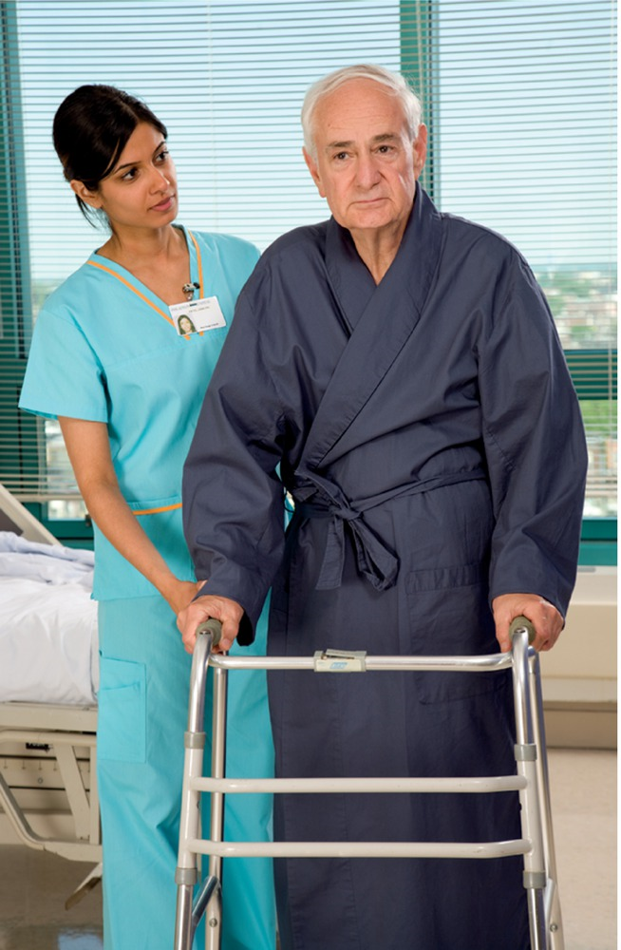

Compassion
Serving all patients is the fundamental function of the sonographer.
Compassion has been defined as a virtuous and intentional response to know a person, discern his or her needs, and alter his or her suffering through relational understanding and action.

Slide 23
Compassion (cont.)
Compassion is an important part of patient care.
With compassion, we have a propensity to feel for our patients and their well-being.
Remind yourself that patients come to you with a certain need; compassion informs your obligation to help those who are ill.

Slide 24
Five Elements of Compassion
Recognition—Recognizing the patient’s adverse circumstance, physical suffering, psychological pain, or emotional well-being
Connection—Personal connection and attentiveness through active communication
Altruistic desire—Selfless help to aid another
Humanistic response—Person-to-person understanding of what it is to be human
Action—Undertaking of an act or responsive behavior

Slide 25
Empathy
Empathy demonstrates that you understand to the point of feeling how another person feels.
This means seeing the world through your patient’s eyes.
An empathetic sonographer listens to patients without judging, demonstrates an honest attempt to understand the patient, and shows willingness to help the patient to the best of his or her abilities.
To develop empathy, one has to attempt to view the world through others’ eyes.
Placing yourself in a patient’s circumstances helps you appreciate what he or she is going through at the time.

Slide 26
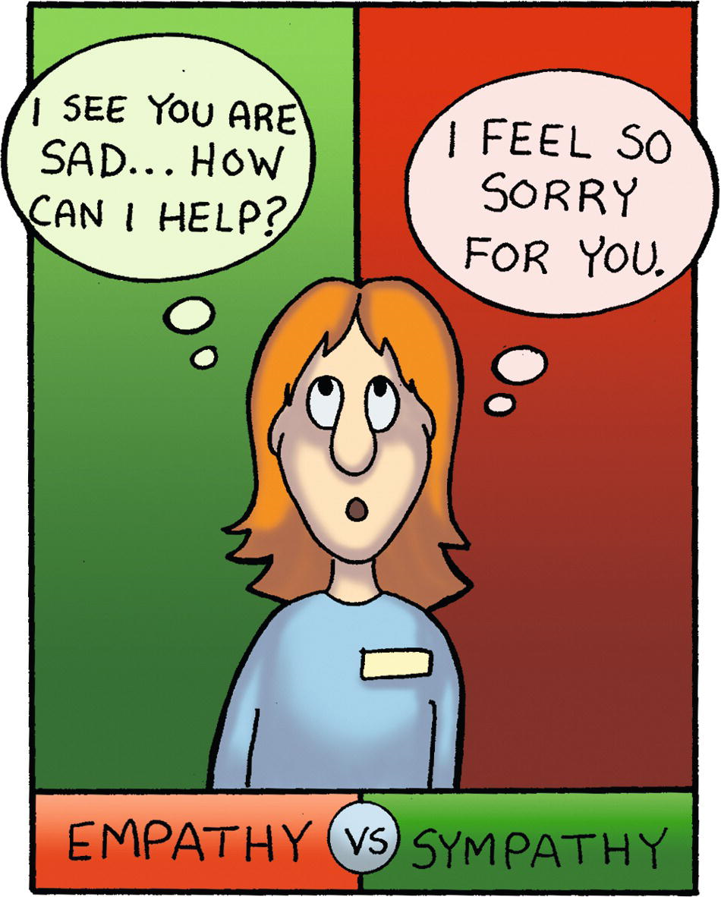
Empathy Versus Sympathy
Empathy demonstrates that you understand to the point of feeling how another person feels. Sympathy is simply feeling sorry for someone.

Slide 27
Altruism
Empathy-altruism hypothesis states that empathy directed toward improving another’s welfare will naturally evoke altruistic behavior.
Altruism is on an even higher level than both compassion and empathy.
Altruism is described as selflessness, taking others’ perspectives, and showing concern for others for the sake of the other rather than oneself.
Specifically, altruistic behavior in patient care focuses solely on others for the sake of others and not for monetary gain, professional recognition, or even patient appreciation.
Simply stated, an altruistic sonographer merely performs the occupation in the hopes of serving others.

Slide 28
Compassion Fatigue—The Cost of Caring
Multiple encounters that require extended amounts of compassion can lead to burnout.
Compassion fatigue results from the combination of traumatic stress and burnout.
Traumatic stress is a consequence of wanting a person who is suffering or traumatized.
Short-term effects include nervousness, cynicism, pessimism, low self-esteem, anger at coworkers, and job dissatisfaction.
Long-term effects include weight issues, overall poor work performance, noticeable personality changes, and a desire to leave the profession.
Sonographers can learn coping techniques that maintain compassion and help prevent compassion fatigue.
The higher EI you have, the less likely you are to suffer from compassion fatigue.

Slide 29
Accountability, Honesty, and Integrity
Healthcare workers must hold themselves accountable.
This means you are responsible for your actions.
Sonographers are accountable to patients, employers, and the profession.
Follow the code of ethics established for sonographers.
Always, “honesty is the best policy.”
Rushing, omitting protocol images, and reporting normal findings despite not spending enough time on an exam can harm a patient.
Behave with integrity.
This includes not cheating even when you could easily get away with it.

Slide 30
Self-Motivation and Enthusiasm
Self-motivation is the ability to do what needs to be done without being influenced or initiated by someone else.
Completing tasks without being told to do so is vital in healthcare.
As a sonographer, you will commonly complete work-related tasks that are not spelled out in your job description.
Self-motivators take it upon themselves to constantly learn about their profession and new equipment, procedures, and techniques.
Your diligence in your classwork and on assignments is an opportunity to show off your self-motivation.
Enthusiasm and a positive attitude are important to maintaining your work ethic.

Slide 31
Hunger for Knowledge and Self-Confidence
Sonography demands you keep current with changes in healthcare through continuing medical education.
Sonographers will also be required to accomplish recertification.
Self-confidence results from self-motivation, thirst for knowledge, and enthusiasm.
This means you believe in yourself and your abilities.
Your confidence will build with practice. Be patient with yourself.
Self-confidence to the point of arrogance can backfire, so be careful not to overstep your bounds as a student.

Slide 32
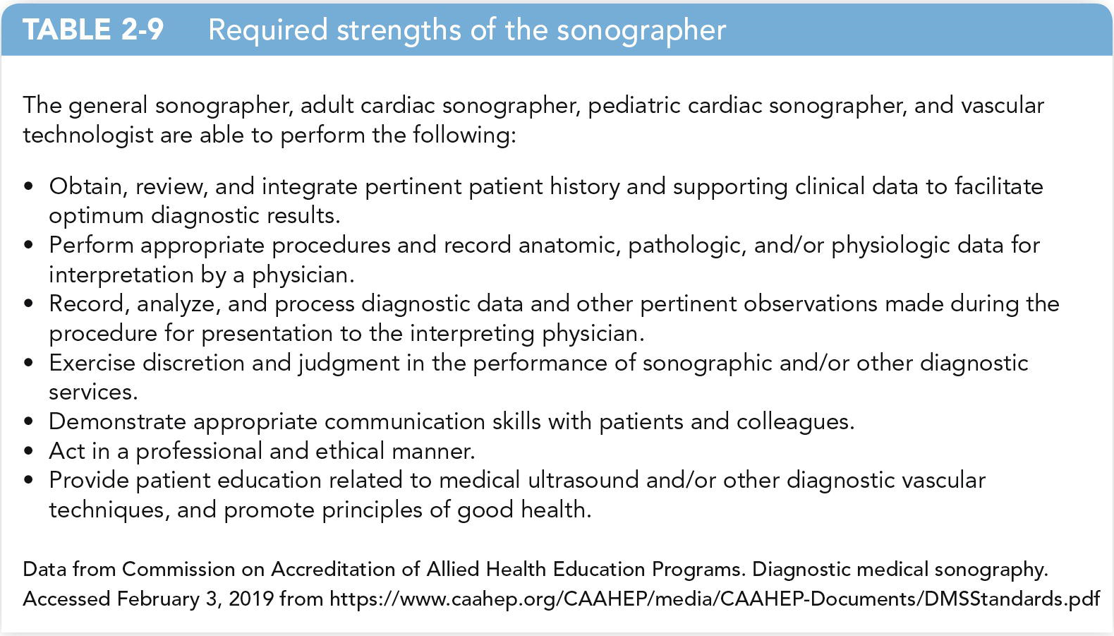
Clinical Responsibilities and Workplace Challenges for the Sonographer
The following are required strengths for the sonographer.

Slide 33
Sonographic Reasoning and Clinical Correlation
Sonographers must obtain a thorough clinical history.
You must be capable of integrating clinical history and applying the gained knowledge to the study to “facilitate optimum diagnostic results.”
This is called sonographic reasoning, which follows these steps:
Clinical history
Clinical hypotheses
Investigative imaging
Sonographic findings
Clinical correlation
Clinical correlation guides you toward a targeted examination.
This is the process of contrasting clinical history with observations.
This is an example of inductive reasoning.

Slide 34
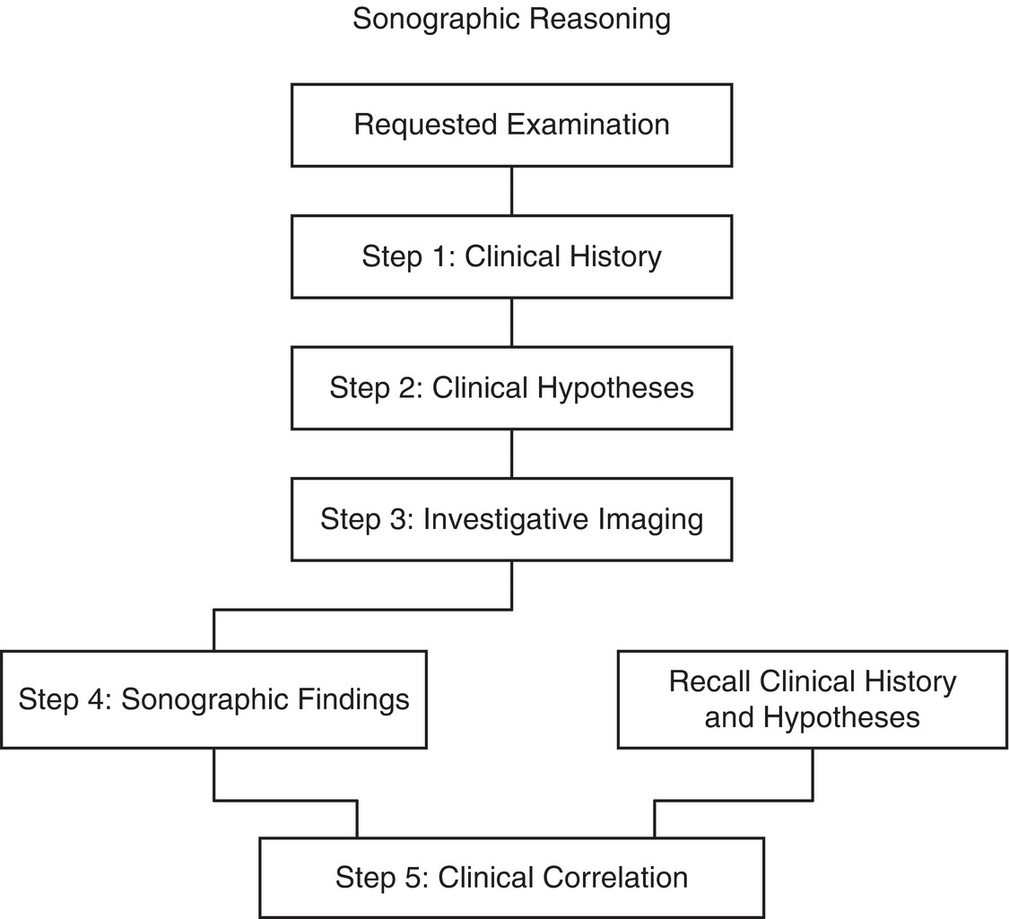
Sonographic Reasoning and Clinical Correlation (cont.)

Slide 35
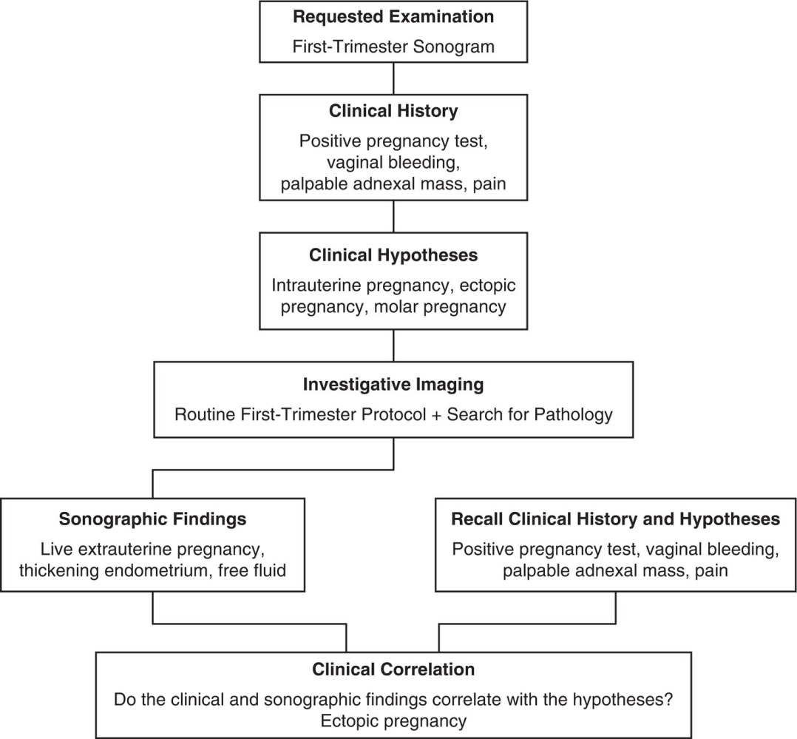
Sonographic Reasoning and Clinical Correlation (cont.)
Sonographic reasoning in action during a first-trimester sonogram

Slide 36
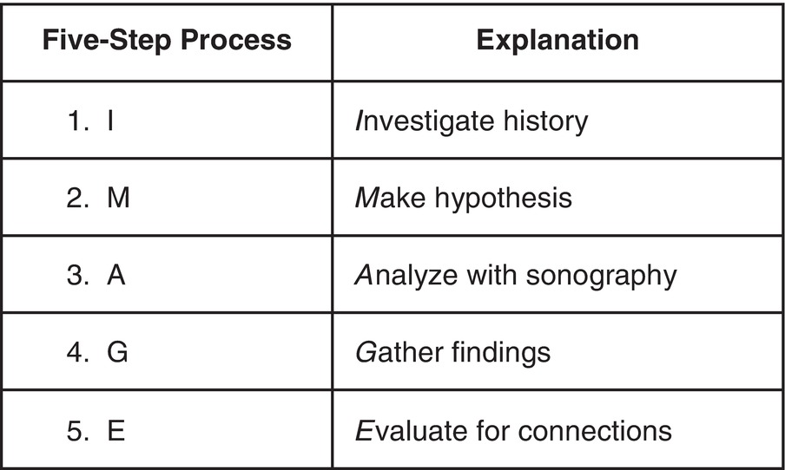
The IMAGE Process
A mnemonic to help you remember the steps in the sonographic reasoning method.

Slide 37
Sonographic Reasoning and Clinical Correlation (cont.)
Clinical correction ambiguity can manifest quickly if you are unaware of how to properly perform sonographic reasoning.
This means a lack in the ability to obtain a thorough clinical history and relate the information with the sonographic findings.
Collecting clinical history assists you in developing a clinical hypothesis.
This allows for more targeted investigative imaging.
The hypothesis must be carefully checked.
Differential diagnoses are diagnoses that may present initially with similar clinical signs and symptoms.

Slide 38
Appreciating Anatomy, Physiology, and Pathology
You must have an appreciation of how the body works and be able to apply that knowledge when performing exams.
Knowing normal sonographic anatomy can help you identify abnormalities.
Sonographic images are obtained in at least two scan planes.
You must be able to recreate a 2D image in your mind in three dimensions.

Slide 39
Tips to Improve Your Hand-Eye Coordination
Play video games (but study first).
Start playing an instrument.
Pick up a new sport or play catch.
Pick up a new hand-eye hobby. Find a new hobby that is both enjoyable and relaxing and that makes you use your hands like sewing, quilting, or painting.

Slide 40
Sonographer Reports
These are written or typed documents proving basic descriptive information about a sonographic examination.
They are used to assist the interpreting physician in making an overall diagnosis.
Reports give comparisons between normally and abnormally appearing structures.
Familiarize yourself with sonographic jargon by studying what the sonographer writes on reports.

Slide 41
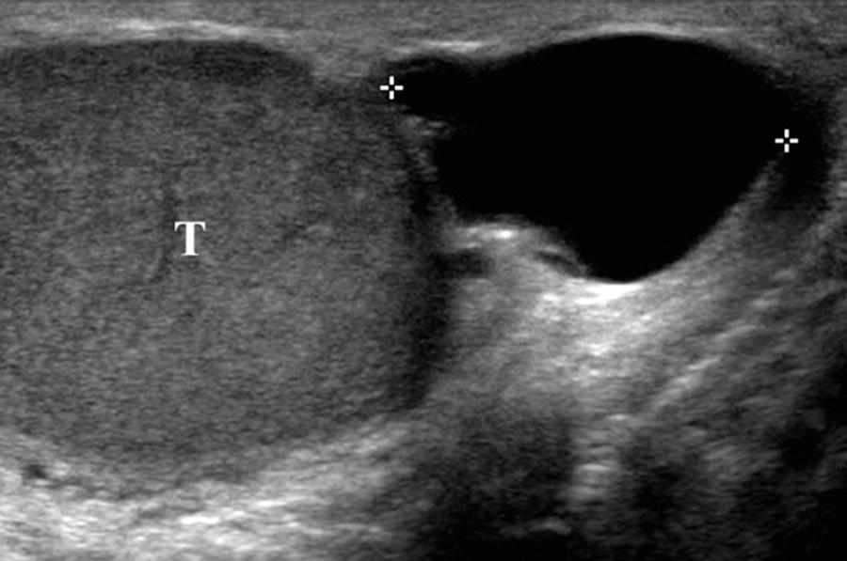
Common Descriptive Terminology
Anechoic—Without echoes, dark on the image, fluid-filled structures, produces acoustic enhancement

Slide 42
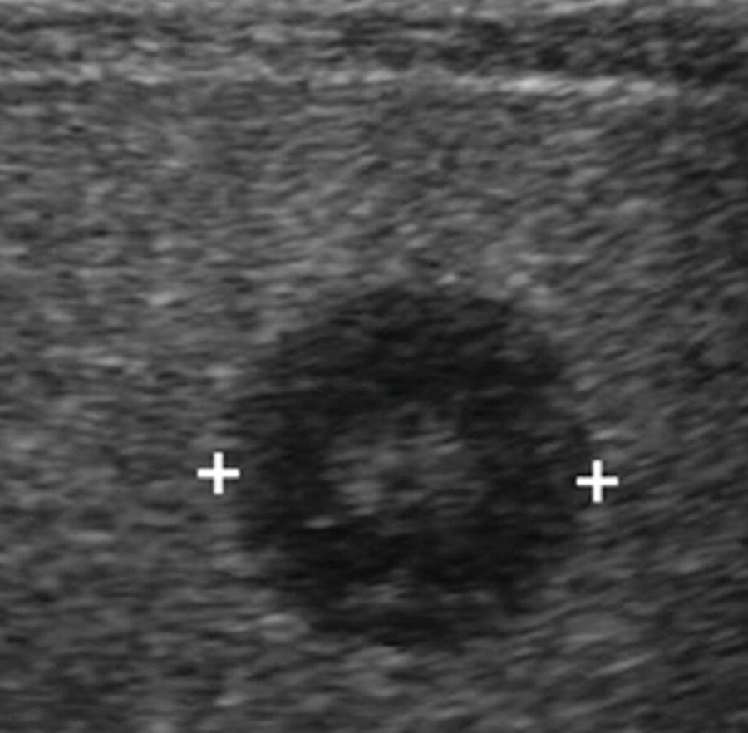
Common Descriptive Terminology (cont.)
Hypoechoic—Having few echoes, dark but not black on the image, comparative term

Slide 43
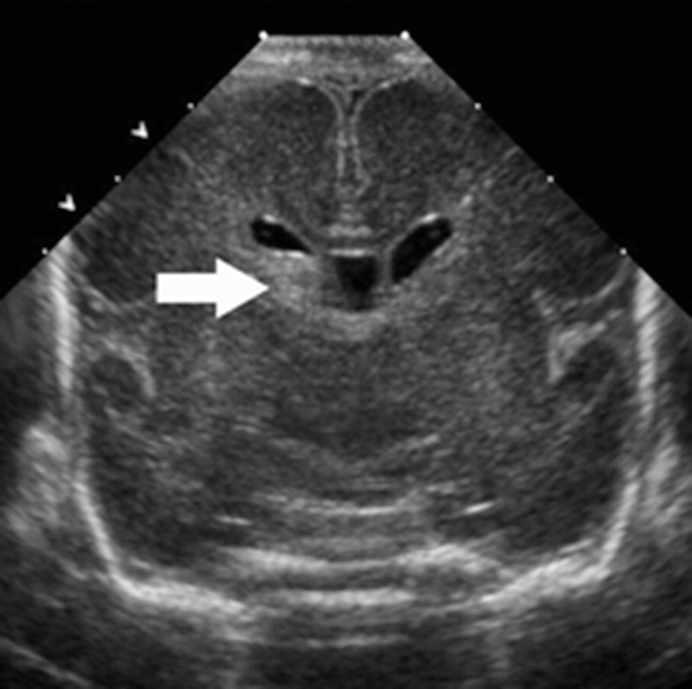
Common Descriptive Terminology (cont.)
Hyperechoic—Having many echoes, bright or gray on the image, may produce posterior shadowing, comparative term

Slide 44
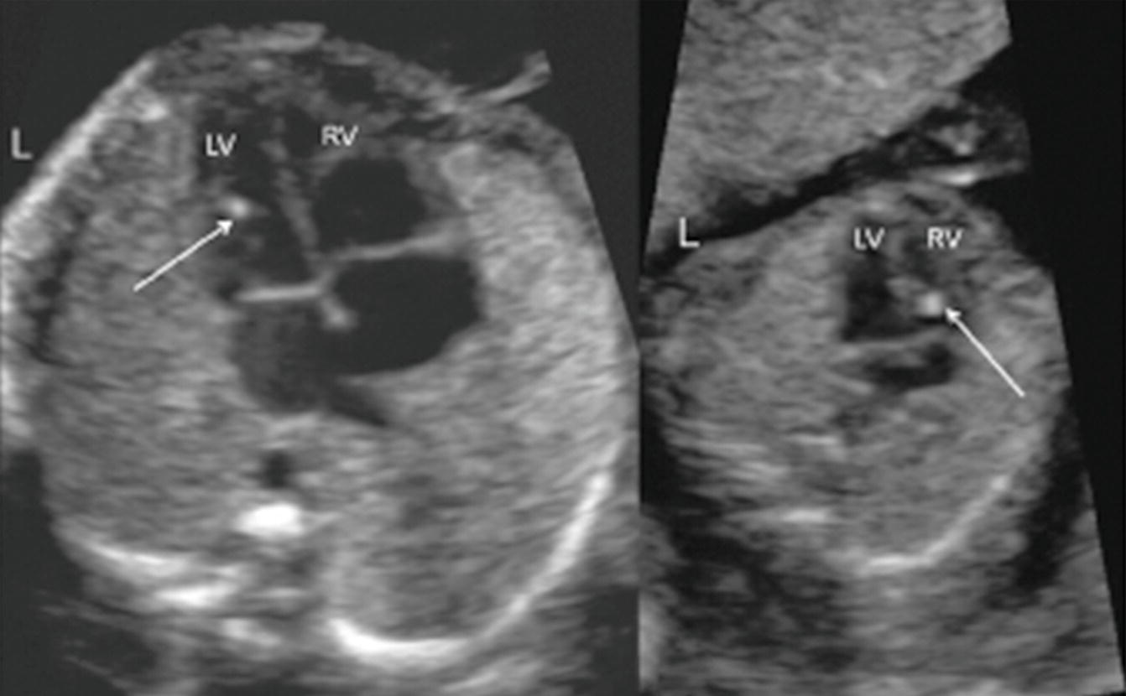
Common Descriptive Terminology (cont.)
Echogenic—Structure that produces echoes, bright or gray on the image, comparative term

Slide 45
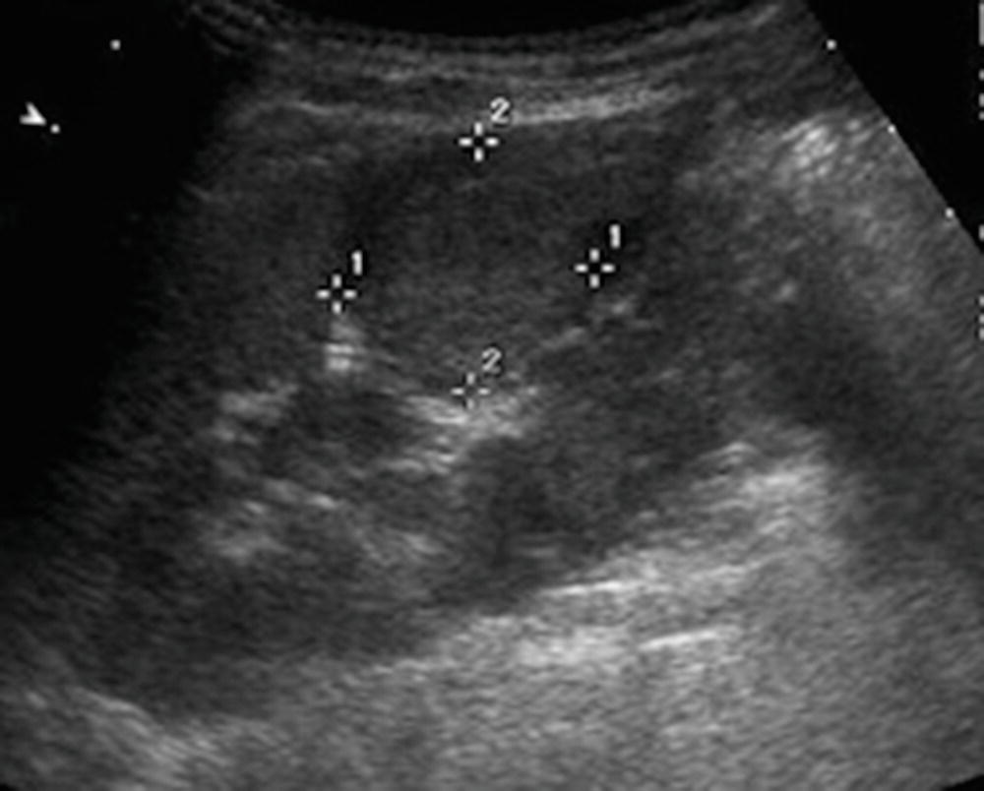
Common Descriptive Terminology (cont.)
Isoechoic—Having the same echogenicity, comparative term

Slide 46
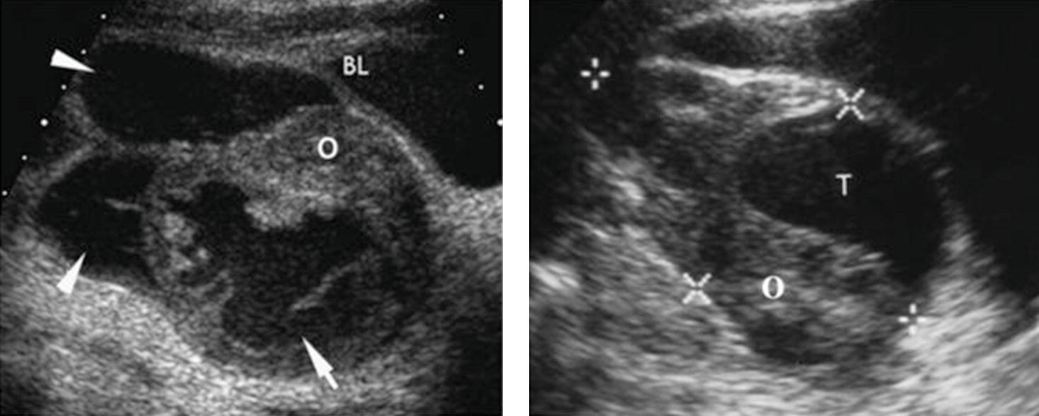
Common Descriptive Terminology (cont.)
Complex (mass)—Having mixed echogenicities, a structure that has both fluid and solid components

Slide 47
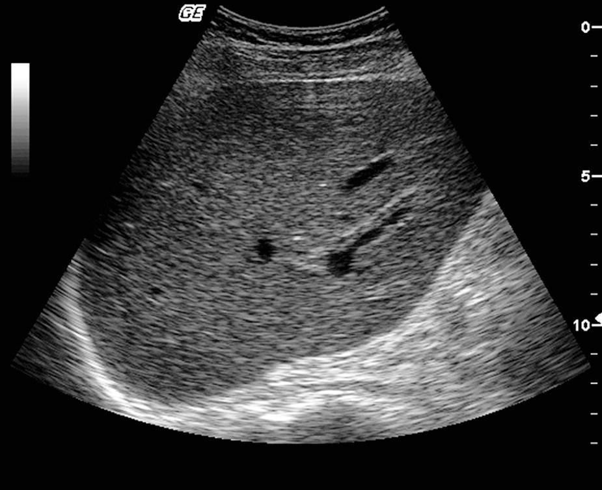
Common Descriptive Terminology (cont.)
Homogeneous—Of uniform composition, smooth structure with consistent echogenicity

Slide 48
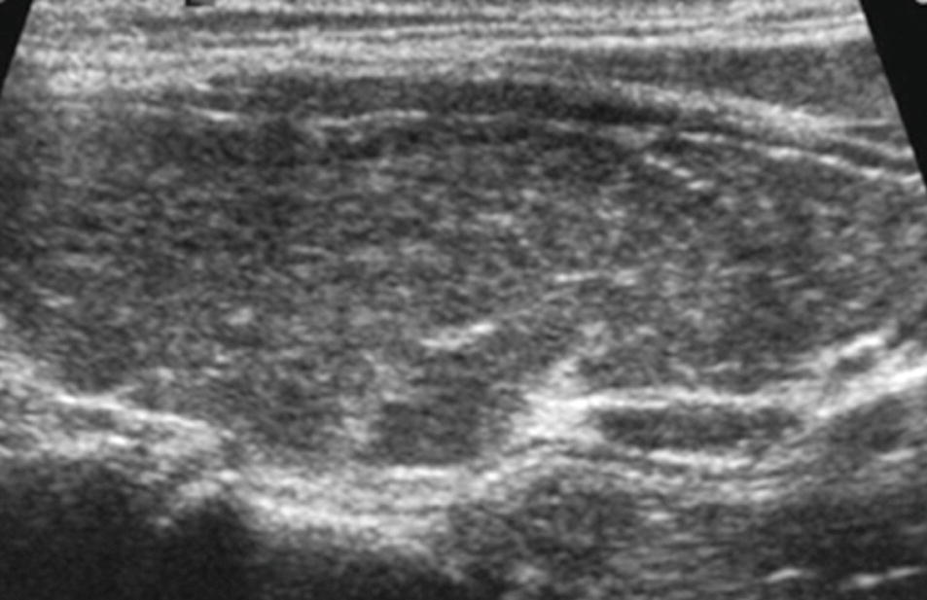
Common Descriptive Terminology (cont.)
Heterogeneous—Of differing composition, patchy structure with inconsistent echogenicity

Slide 49
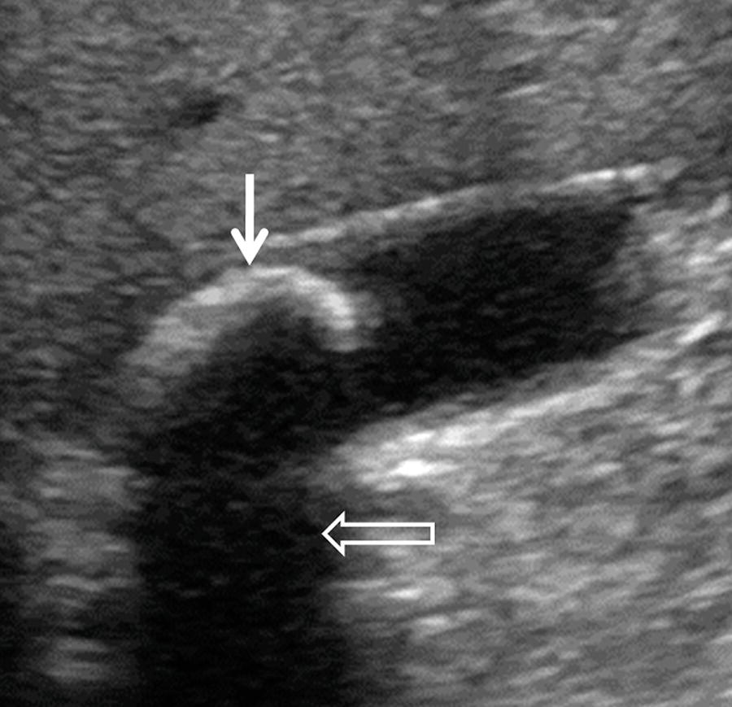
Common Descriptive Terminology (cont.)
Shadowing—Failure of the sound beam to pass through an object

Slide 50
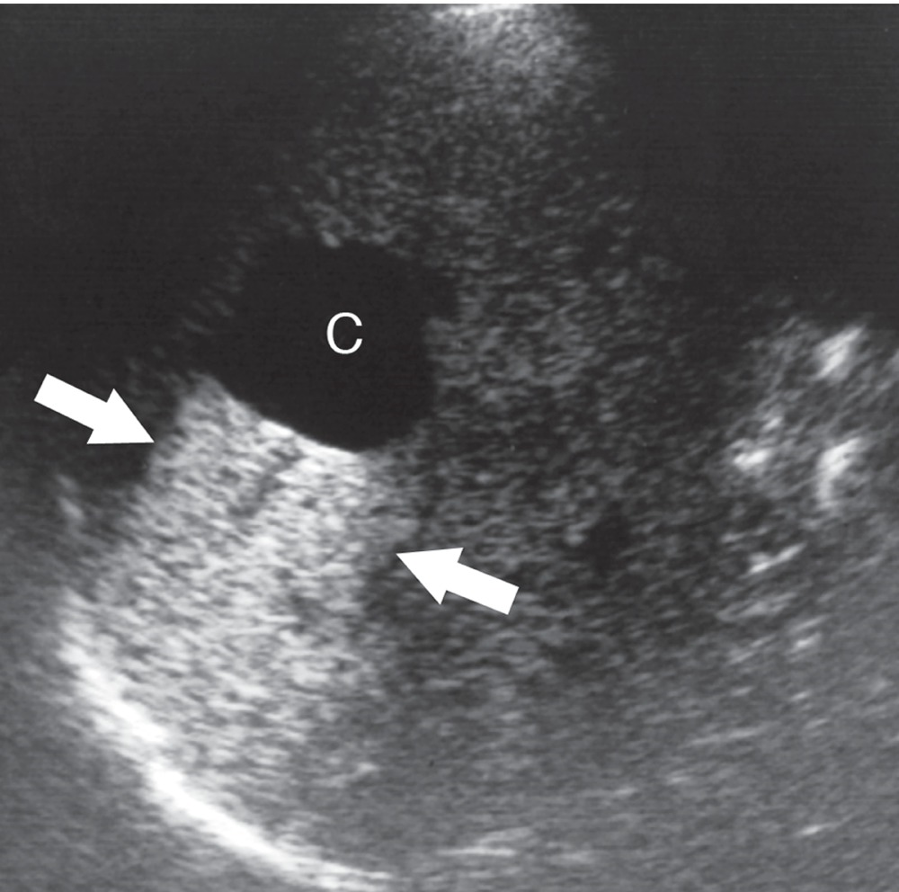
Common Descriptive Terminology (cont.)
Acoustic enhancement—Area of brightness seen distal to a weakly attenuating reflector

Slide 51
Occupational Stress for the Sonographer
Stress related to job duties in the workplace can result in negative psychological and physiologic effects.
Role ambiguity is frustration that rises when job expectations differ between employer and employee.
Additional job duties beyond performing sonograms can lead to stress.
Stressors include demanding work schedules and taking call.
Sonographers must work at a consistently high intellectual and physical level for 8 or 12 hours at a time.
Burnout can negatively affect your work and patient care.
It is important to recognize the symptoms of burnout and work with your employer to make effective changes to the work environment.

Slide 52
Student Interaction with Sonographers
Establishing a good working relationship with a sonographer will afford you a great opportunity to learn.
When and How to Communicate
The best place to talk is outside of the ultrasound room out of patient earshot.
The workstation where images are viewed, and reports are created may be a good place.
Never discuss pathology or point at the monitor while in the room in front of a patient.
Acquiring Scan Time
Examine the schedule and plan ahead.
Make a list of daily tasks to accomplish.
Scan before or after the exam for a few minutes.
Know your protocols well.

Slide 53
Ways to Annoy Sonographers
Complaining about everything
Always asking questions
Being overconfident
Being lazy
Being the consummate rule-breaker
Getting personal

Slide 54
Tips for Getting More Scan Time
Examine the schedule, and plan ahead. Inform the sonographers of tasks or full exams that you would like to perform.
Make a list of daily tasks to accomplish. Try to focus on specific anatomy to identify as you scan throughout the day to save time.
Scan before or after the exam for a few minutes.
Ask if you could begin the examination or scan after the sonographer finishes.
Know your protocols well. Really understanding the protocol will increase your speed and help you acquire more scanning experience.

Slide 55
Student Interaction with Interpreting Physicians
Watching a physician dictate reports or discuss cases is an outstanding way to learn.
Sonographers must gain the physician’s trust.
Observe and appreciate interactions between the physician and the sonographer.
Listen carefully to how the sonographer presents cases.
When speaking to a physician:
Remain respectful.
Pay attention vigilantly.
Be inquisitive and make mental notes.
If asked a question, answer appropriately and do not hesitate to tell the physician when you do not know the answer.

Slide 56
Summary
The sonographer’s obligation in the clinical setting is to provide compassionate patient care while simultaneously performing complicated sonographic examinations.
From the research, it is evident that although the occupation of sonographer is challenging, it is also highly respected, and it can be a rewarding job both professionally and personally.

